Slide 1
Biol 7200: Programming for Bioinformatics Glob and Working with text files

Slide 2
Schedule for today
Patterns (glob)
File manipulation
File content analysis
Questions/issues so far

Slide 3
Schedule for today
Patterns (glob)
File manipulation
File content analysis
Questions/issues so far

Slide 4
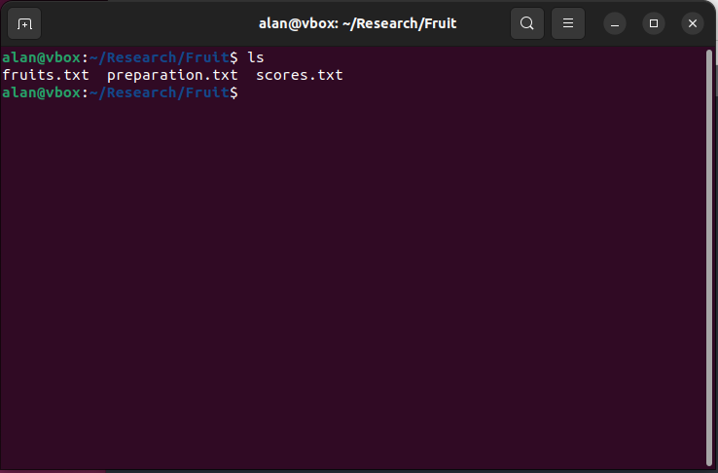
Working with text files in bash
Bioinformatic data is often stored in text files (tsv, csv, txt, fasta, etc)
Bash has many handy tools to manipulate large text files quickly
In addition, Bash has powerful pattern matching behaviours
Combined these make Bash extremely effective for file manipulations

Slide 5
What is pattern matching?
Pattern matching is using a pattern (set of special characters) to describe one or more different strings
Bash uses glob to match strings of characters
Glob defines a set of special characters which are interpreted by Bash to describe a pattern
Many shells also support “extended” glob with additional pattern options

Slide 6
Glob special characters
Glob pattern | Glob or extglob? | Meaning
* | Glob | 0 or more of any character
? | Glob | 1 of any character
[abc] | Glob | 1 of the given characters (i.e., a, b, or c in this case
?(patterns) | Extglob | One or more multi-character patterns delimited by “|” symbols where ? is a quantifier
[?*+@!](patterns) | Extglob | When preceding a set of patterns, ?, *, +, @, and ! are quantifiers
Glob quantifier | Meaning
? | 0 or 1
* | 0 or more
+ | 1 or more
@ | 1
! | Match anything that doesn’t match specified pattern(s)

Slide 7
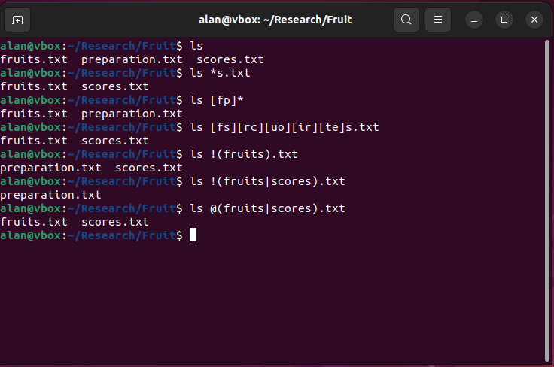
Globbing in action

Slide 8
Schedule for today
Patterns (glob)
File manipulation
File content analysis
Questions/issues so far

Slide 9
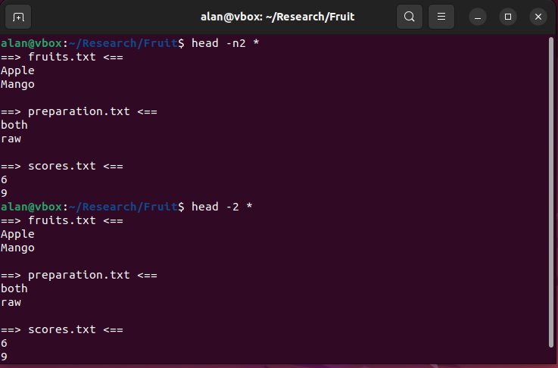
Head returns the top n lines of a file or files
Default returns top 10 lines
Can call with head –n <number> to set number of lines
Also works with head -<number>

Slide 10
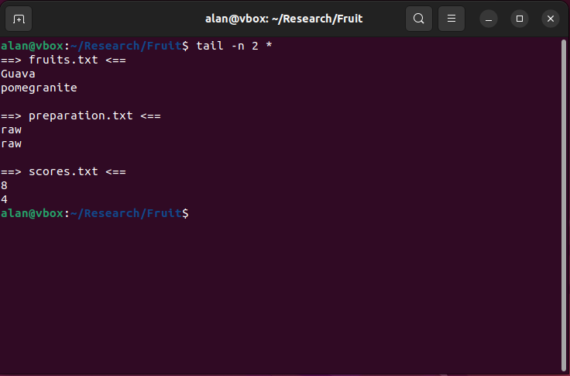
Tail returns the bottom N lines
Usage is the same as head
Both can also return lines from/until some point
head –n -<N> returns all until the Nth from last line
tail –n +<N> returns from the Nth line onwards

Slide 11
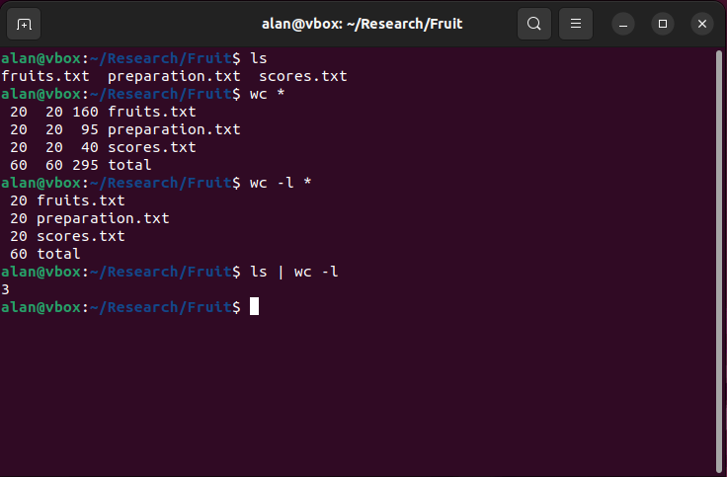
Wc counts lines, words, and bytes in a file
Counts contents of specified files
Count of interest can be specified using [-lwc]
Useful for checking file sizes and number of results returned by commands

Slide 12
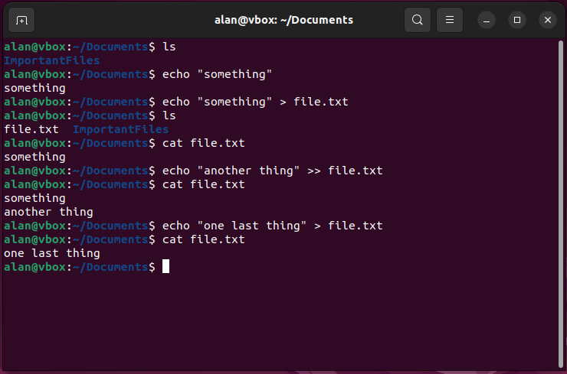
Recap from last week: redirecting stdout
Bash has two stdout redirects:
> and >> both redirect to a file
| redirects to the stdin of another process
> overwrites an existing file (creates the file if it didn’t exist)
>> appends to an existing file (creates the file if it didn’t exist)

Slide 13
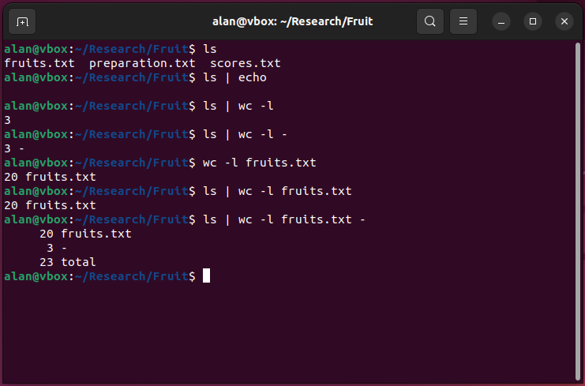
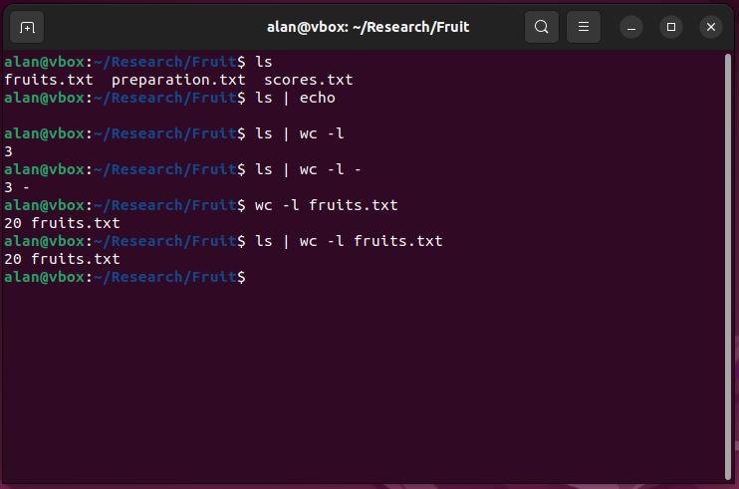
“|” (Pipe) redirects stdout to another process
Not all processes take input from stdin
Those that do can accept piped stdout
Follows the syntax command1 | command2
stdin can be passed explicitly with “-”

Slide 14
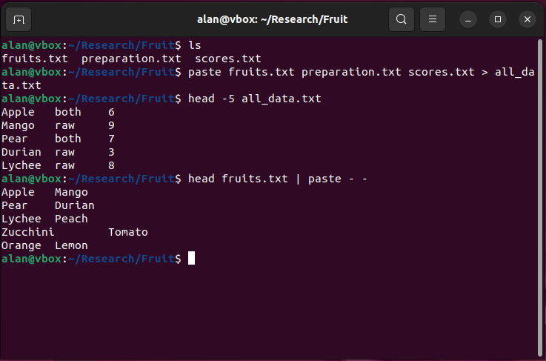
Paste combines inputs column-wise
cat stacks inputs on top of one another
paste places corresponding lines of provided files into columns (default behaviour)
paste can also accept stdin using -
Good way to quickly subset data when combined with cut
paste can take both stdin and files as input (i.e., <command> | paste - <file>)

Slide 15
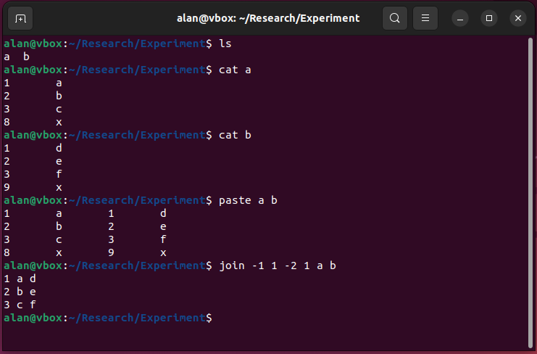
Join combines files with common data
join can be used to combine files containing shared information or values
Like paste, but uses a common field in files
Requires sorted input
Ignores lines without shared data

Slide 16
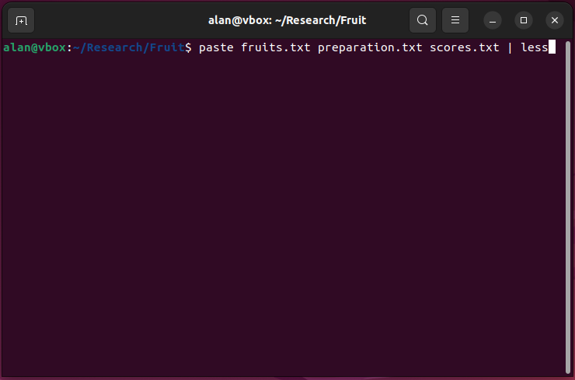
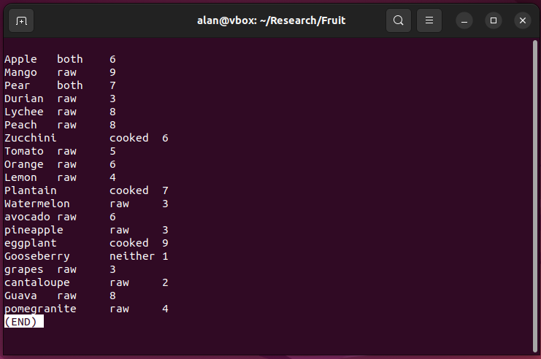
Less lets you view a file or explore output
less <file> to view a file
<command> | less to view stdout
Quick with huge files – doesn’t load the whole file
Supports text search
Navigate with up/down pageup/pagedown
Quit with q
See help with h

Slide 17
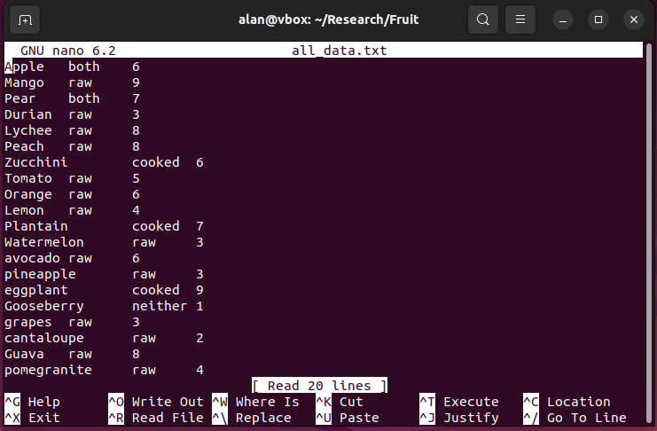
Your shell has text editors
Sometimes you may not have access to a graphical user interface
You can use terminal-based text editors
nano provides basic functionality
vi is more involved but more feature-rich
Others are available such as vim and emacs

Slide 18
Schedule for today
Patterns (glob)
File manipulation
File content analysis
Questions/issues so far

Slide 19
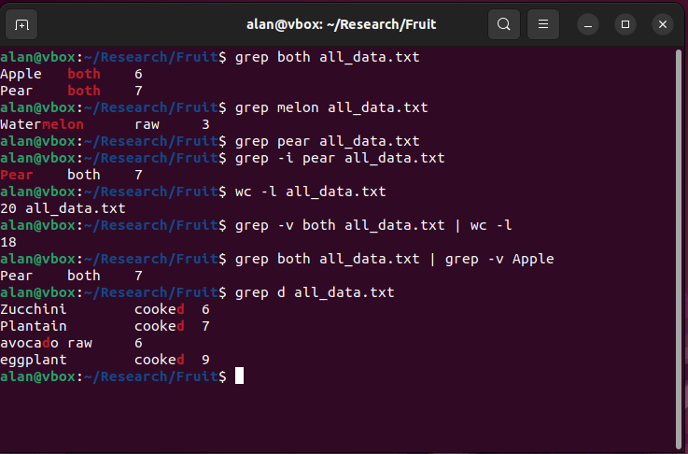
Grep searches text for regular expressions / strings
Short for global regular expression search and print
We’ll cover regular expressions (regex) later
grep finds strings/patterns in text and returns lines containing a match
Tip: use grep to search help messages by calling e.g., grep --help | grep case

Slide 20
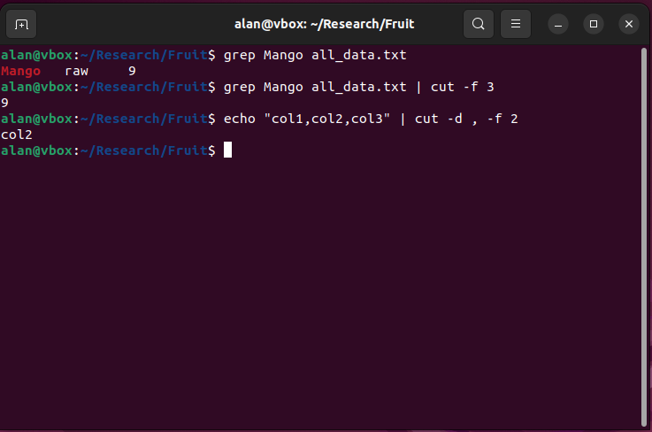
Cut extracts columns from tabular data
Extracts columns based on the specified delimiter (default tab)

Slide 21
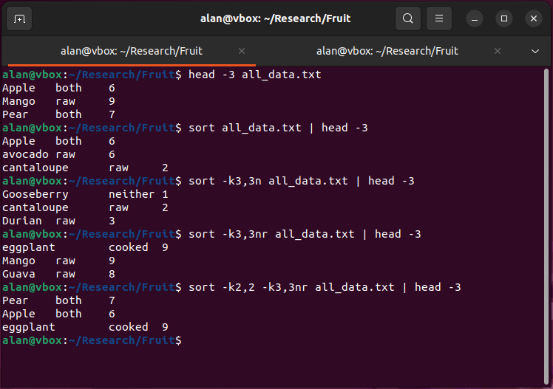
Sort sorts tabular data according to column values
Default is alphabetical sort of whole lines (e.g., 1001 before 20)
Can specify column preference and mode
Can sort each column with different rules (numerical, alphabetical, reverse…)
Column specifications are –k [<start>][,<stop>][modes]

Slide 22
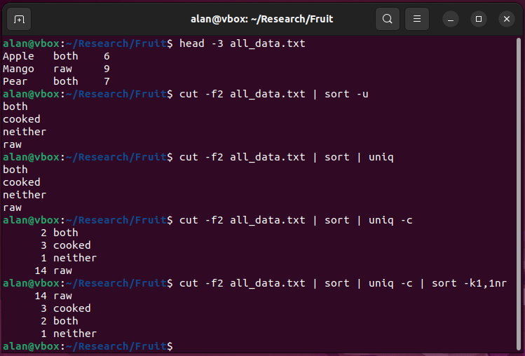
Sort can also return just unique elements of an input
Reads whole lines so cut columns if desired
Another command, uniq, can also return unique elements and can count them
Very useful combination for exploring data
Note: uniq requires sorted input

Slide 23
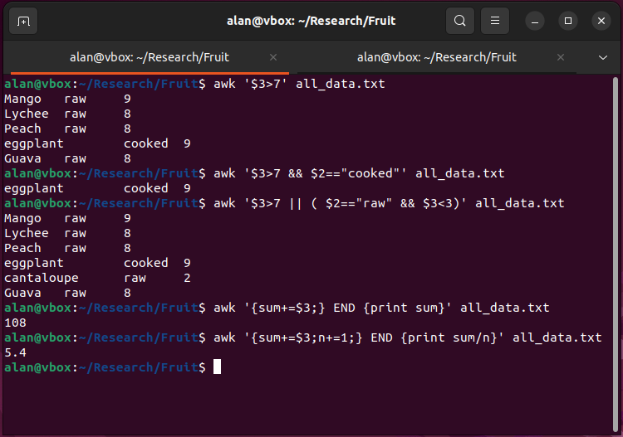
Awk is a programming language with powerful one-liners
Designed to process text data line by line
awk programs can be very simple or very complex
$ used to denote columns. $3 == column 3, $0 == whole line
Basic usage specifies a condition. Lines matching the condition are printed (e.g., 1st example is actually doing this awk ‘$3>7 {print $0}’)
Multiple conditions can be specified using Boolean operators && and || parentheses
Recommended (skim) reading: https://www.gnu.org/savannah-checkouts/gnu/gawk/manual/gawk.html#Part-I_003a-The-awk-Language

Slide 24
Sed edits text files or streams
Stream editor with various edit modes
Common operations:
Replace strings (note global mode)
Extract/delete lines containing strings (see also grep)
Extract/delete line ranges
Can perform multiple operations using -e to specify each “expression”
Supports regex and match groups (more later)
Recommended (skim) reading: https://www.gnu.org/software/sed/manual/sed.html

Slide 25
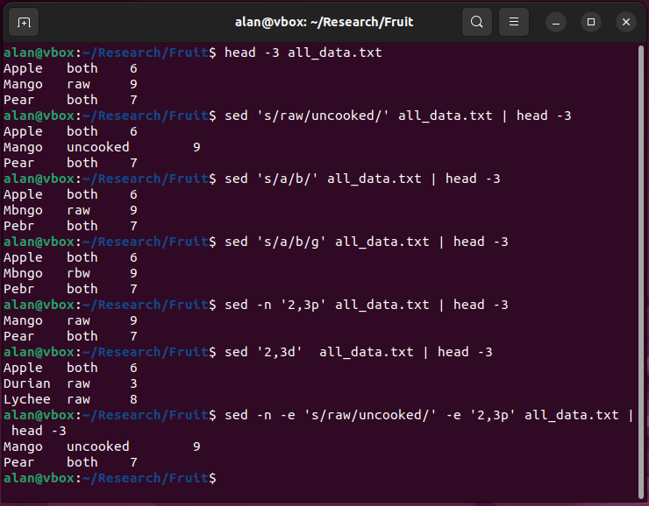
Sed edits text files or streams
Usage:
Replace: ‘s/<pattern>/<replace>/[g]’
Print (line nums): -n ‘<start>,<stop>p’
Delete (line nums): ‘<start>,<stop>d’
Delete (pattern) (see also grep -v): ‘/<pattern>/d’

Slide 26
Schedule for today
Patterns (glob)
File manipulation
File content analysis
Questions/issues so far

Slide 27
Questions or Issues getting set up?

Slide 28
End of Lesson

